Slide 1

CZ2007 Introduction to Databases
Querying Relational Databases using SQL
Part-5
Arijit Khan
Assistant Professor
School of Computer Science and Engineering
Nanyang Technological University, Singapore
arijit.khan@ntu.edu.sg

Slide 2
Schedule after Recess Week
- Week 8 (Oct 04-Oct 08)
- Week 9 (Oct 11-Oct 15)
- Week 10 (Oct 18-Oct 22)
- Week 11 (Oct 25-Oct 29)
SQL
Week 12 (Nov 01-Nov 05)
Quiz during Tutorial session
- Quiz syllabus: everything on SQL (Week 8, 9, 10 11)
Semi-Structured Data
- Week 13 (Nov 09-Nov 13)

Slide 3



Recap: Roadmap (SQL)
Introduction to SQL
Lecture-1
Querying single relation
Lecture-2
Ordering Tuples
Multi-relation queries
Subqueries
Set operations
Bag semantics
Join expressions
Aggregation
Lectures-3 & 4
arijit.khan@ntu.edu.sg
2/28

Slide 4

Recap: Roadmap (SQL)
Groupings
Creation of tables
Database modifications
Constraints
Views
Lecture-5 & 6
Today’s lecture: Chapter 6.7, Chapter 7 of the Book “Database Systems: The Complete Book; Hector Garcia-Molina Jeffrey D. Ullman, Jennifer Widom
Triggers
Indexes
Lecture-7 & 8
That would be all about Quiz-2!!
arijit.khan@ntu.edu.sg

Slide 5
Today’s Lecture
Constraints
Views
arijit.khan@ntu.edu.sg
4/28

Slide 6
Questions?
arijit.khan@ntu.edu.sg
5/28

Slide 7

Constraints
What is constraints?
A relationship among data elements that a DBMS is required
to enforce
Types
Keys
Foreign keys or referential integrity
Value-based constraints
Constrain values of a specific attribute
Tuple-based constraints
Relationship among components
Assertions: Any SQL boolean expression
arijit.khan@ntu.edu.sg
6/28

Slide 8
Attribute-based Checks
CREATE TABLE Sells (
bar CHAR(20),
beer CHAR(30)
CHECK (beer IN (SELECT name FROM Beers)),
price REAL CHECK (price <= 18.00),
);
An attribute-based check is checked only when a value for
that attribute is inserted or updated
not checked at the time of deletion, i.e., not checked when a bear
is deleted from Beers table (unlike foreign keys)
arijit.khan@ntu.edu.sg
7/28

Slide 9
Tuple-based Checks
Only WOOBAR can sell beer for more than $10
CREATE TABLE Sells (
bar CHAR(20),
beer CHAR(30),
price REAL,
CHECK (bar = ‘WOOBAR’ OR price <= 10.00)
);
Checked whenever a tuple is inserted or updated
arijit.khan@ntu.edu.sg
8/28

Slide 10
Assertions
Database schema constraints
Not available with many DBMS
Condition can refer to any relation or attribute in the database schema
We must check every ASSERTION after every modification to any relation of the database
Syntax
CREATE ASSERTION <name>
CHECK (condition);
arijit.khan@ntu.edu.sg
9/28

Slide 11
Assertions - Example
In Sells(Bar, Beer, Price), no bar may charge an average of more than $10.
CREATE ASSERTION NoRipOffBars CHECK (
NOT EXISTS (
SELECT bar
FROM Sells
GROUP BY bar
HAVING AVG(price) > 10.00
)
);
arijit.khan@ntu.edu.sg
10/28

Slide 12
Assertions – More Example
In Drinkers(name, addr, phone) and Bars(name, addr, license), there cannot be more bars than drinkers.
CREATE ASSERTION FewBars CHECK (
(SELECT COUNT(*) FROM Bars) <=
(SELECT COUNT(*) FROM Drinkers)
);
arijit.khan@ntu.edu.sg
11/28

Slide 13
Questions?
Constraints
Views
arijit.khan@ntu.edu.sg
12/28

Slide 14
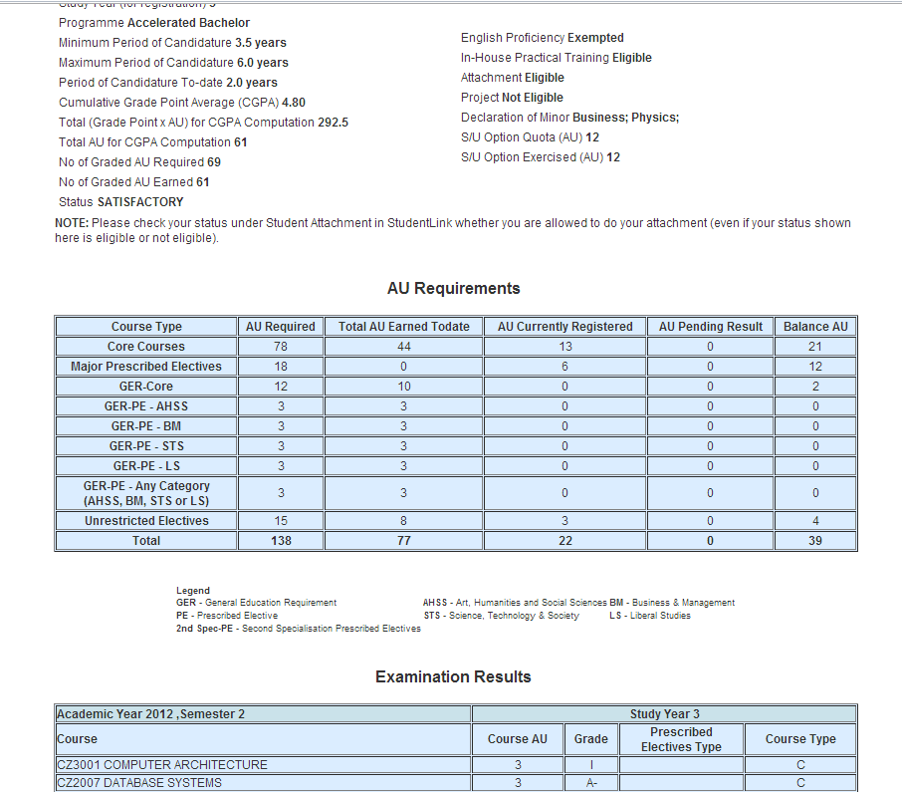
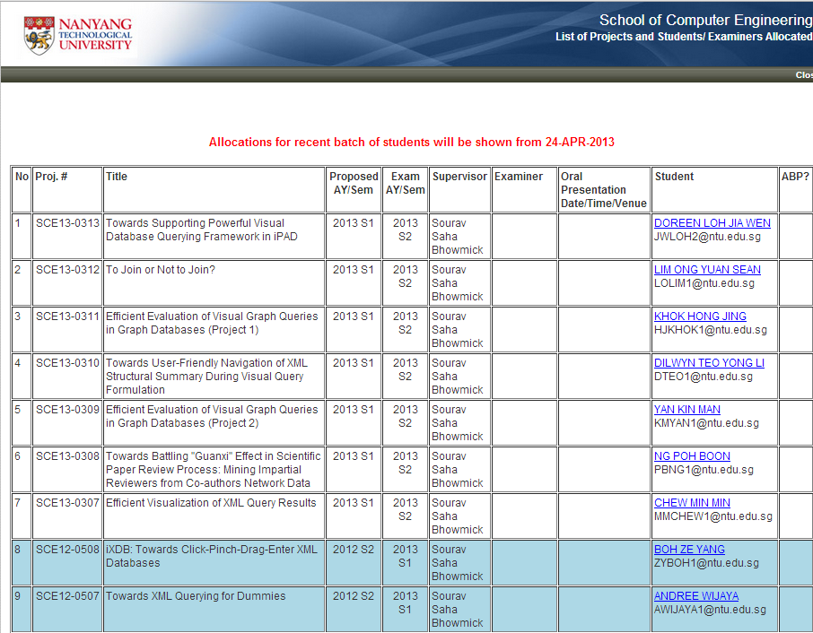
Views
Student, Course, Enrollment…
arijit.khan@ntu.edu.sg
13/28

Slide 15
Views
A view is the dynamic result of a query over the base relations to produce another relation.
It is considered virtual because it does not usually exist inside the database, but rather is calculated when needed.
A view appears just like any other table and can be present in any SQL query where a table is present.
arijit.khan@ntu.edu.sg
14/28

Slide 16
Views - Example
CREATE VIEW <name> AS <query>;
Example
CanDrink(drinker, beer) is a view “containing” the drinker-beer pairs such that the drinker frequents at least one bar that serves the beer.
CREATE VIEW CanDrink AS
SELECT drinker, beer
FROM Frequents, Sells
WHERE Frequents.bar = Sells.bar;
arijit.khan@ntu.edu.sg
15/28

Slide 17
What is Stored in Databases
Only the view definition
CREATE VIEW CanDrink AS
SELECT drinker, beer
FROM Frequents, Sells
WHERE Frequents.bar = Sells.bar;
Results of the query defining the view is not produced!
arijit.khan@ntu.edu.sg
16/28

Slide 18
Querying with Views
You may query a view as if it were a base table.
SELECT beer
FROM CanDrink
WHERE drinker = ‘Sally’;
DBMS maps a query expressed on views into a query expressed on base relations in compile time
arijit.khan@ntu.edu.sg
17/28

Slide 19
Update with Views
All views can be queried as base relations, but not all views can be manipulated.
A view is updatable only if the updates to the view can be propagated to the base relations without ambiguity.
arijit.khan@ntu.edu.sg
18/28

Slide 20
Update with Views - Example
Drinkers(name, addr, phone)
CREATE VIEW UnivDrinker AS
SELECT name, addr
FROM Drinkers
WHERE addr = ‘NTU’ OR addr = ‘NUS’;
INSERT INTO UnivDrinker
VALUES (`Sally’, ‘NUS’);
Inserts (‘Sally’,’NUS’, NULL) into Drinkers relation
19/28

Slide 21
Update with Views - Example
Drinkers(name, addr, phone)
CREATE VIEW NTUDrinker AS
SELECT name
FROM Drinkers
WHERE addr = ‘NTU’;
INSERT INTO NTUDrinker
VALUES (`Sally’);
Inserts (‘Sally’,’NTU’, NULL) into Drinkers relation
20/28

Slide 22

Update with Views - Example
Relational Tables
Sells(bar, beer, price) Frequents(drinker, bar)
CREATE VIEW CanDrink AS
SELECT drinker, beer
FROM Frequents, Sells
WHERE Frequents.bar = Sells.bar;
INSERT INTO CanDrink
VALUES (`Sally’, ‘Heineken’);
arijit.khan@ntu.edu.sg
21/28

Slide 23
Update with Views - Rules
Updatable views
Only if they are derived from a single relation by selection and projection
Non-updatable views
Views defined using groups and aggregate functions are not updatable
Views defined on multiple tables using joins are generally not updatable
Only updatable if they include the keys of the base relations
arijit.khan@ntu.edu.sg
22/28

Slide 24
Questions?
arijit.khan@ntu.edu.sg
23/28

Slide 25
Temporary Views
WITH clause
Allows to define a temporary view whose definition is only available to the query in which the WITH clause occurs
Introduced in SQL 99
Only supported by some DBMS vendors
arijit.khan@ntu.edu.sg
24/28

Slide 26
Temporary Views - Example
WITH CanDrink(drinker,beer) AS
SELECT drinker, beer
FROM Frequents, Sells
WHERE Frequents.bar = Sells.bar
SELECT drinker
FROM CanDrink
WHERE beer = ‘Tiger’;
Advantages
Makes the logic simpler to follow
Permits a view definition to be used multiple times in a query
arijit.khan@ntu.edu.sg
25/28

Slide 27
SELECT INTO vs. VIEWS
SELECT drinker, beer
INTO DrinkerBeer
FROM Sells, Frequent
WHERE Frequents.bar = Sells.bar;
A Table is created
(Physical)
CREATE VIEW DrinkerBeer AS
SELECT drinker, beer
FROM Frequents, Sells
WHERE Frequents.bar = Sells.bar;
A Definition is created (Virtual)
arijit.khan@ntu.edu.sg
26/28

Slide 28
VIEWS vs. TEMPORAL VIEWS
CREATE VIEW DrinkerBeer AS
SELECT drinker, beer
FROM Frequents, Sells
WHERE Frequents.bar = Sells.bar;
- Definition (Virtual)
- Can be used in many queries in the future
WITH CanDrink(drinker,beer) AS
SELECT drinker, beer
FROM Frequents, Sells
WHERE Frequents.bar = Sells.bar
SELECT drinker
FROM CanDrink
WHERE beer = ‘Tiger’;
- Definition (Virtual)
- Can ONLY be used in the current query
arijit.khan@ntu.edu.sg
27/28

Slide 29
Summary
Constraints
Views
arijit.khan@ntu.edu.sg
28/28

Slide 30

arijit.khan@ntu.edu.sg

